Slide 1


NEXT GEN EMPLOYABILITY PROGRAM
CREATING A FUTURE-READY WORKFORCE
Student Name :
Mali Vikas Bharat
Student ID :
College Name :
STU677276fb6f84a1735554811
SHRI VILE PARLE KELAVANI MANDAL'S INSTITUTE of Dhule

Slide 2
CAPSTONE PROJECT SHOWCASE
Project Title
Online Auction Platform with React and ExpressJS Framework​ (P2)
Abstract | Problem Statement | Project Overview | Proposed Solution | Technology Used | Modelling & Results | Conclusion | Q&A

Slide 3
Abstract
1
Using React for the frontend
2
Using ExpressZ framework for the backend
3
Real-time interaction with database
4
Responsive, and Interactive Environment

Slide 4


Problem Statement
Traditional auction systems lack real-time interaction, scalability, and modern UI experiences. There is a need for a digital platform that provides fast, reliable, and user-friendly auctioning with real-time updates.

Slide 5

Project Overview
The Auction Platform allows users to register, create auction listings, and participate in live bidding. It ensures data consistency and real-time bid updates, providing an engaging user experience.

Slide 6
Proposed Solution
Implement a web-based auction system using React and ExpressZ. The platform will feature user authentication, and an admin interface. Security and scalability are prioritized through modular architecture and efficient backend processing.

Slide 7
Technology used
- Frontend: React
- Backend: ExpressZ Framework (Node.js)
- Database: MongoDB
- Authentication: JWT
- Hosting: AWS (Amazon Web Services)

Slide 8
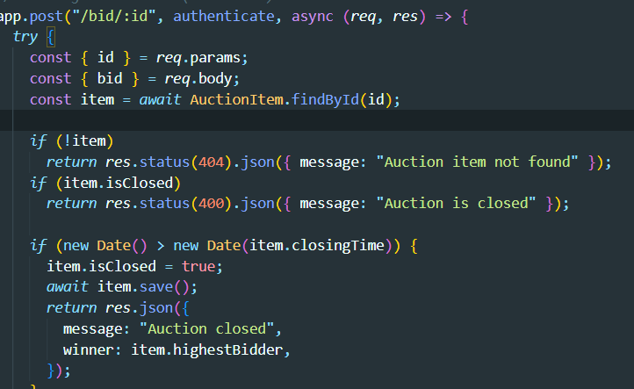
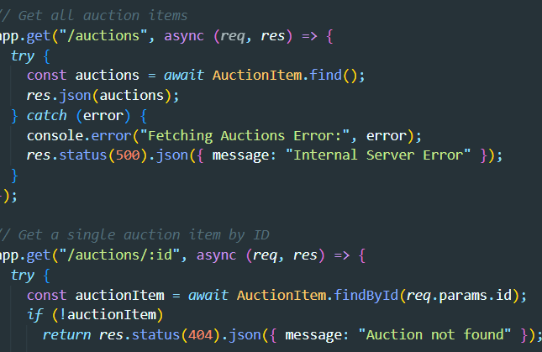
Modelling & Result

Slide 9
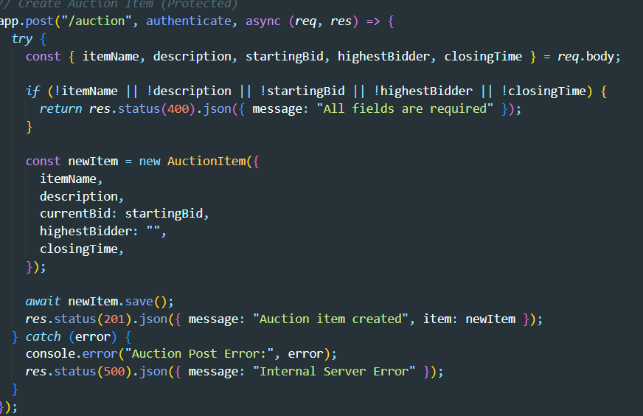
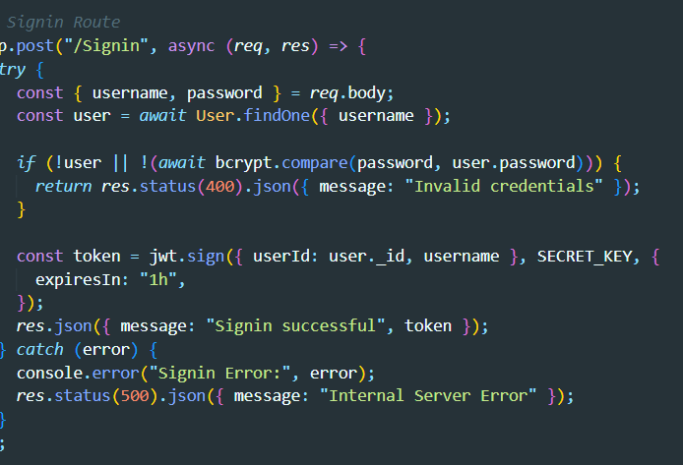
Modelling & Result

Slide 10
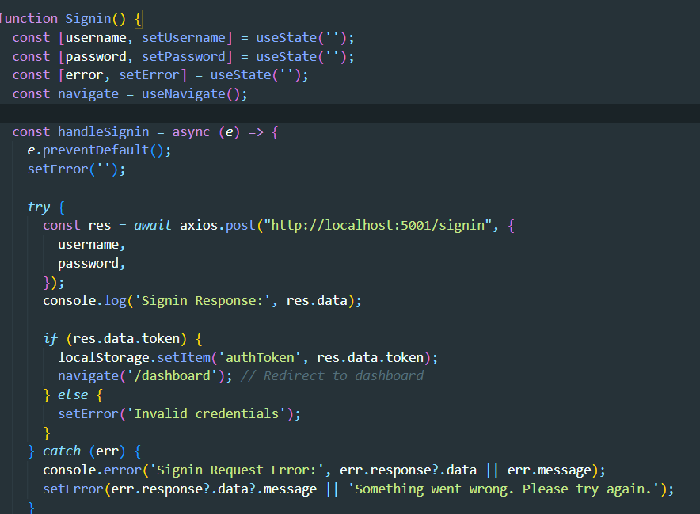
Modelling & Result

Slide 11

Conclusion
The Auction Platform demonstrates a successful implementation of a real-time auction system using modern web technologies. It is scalable, secure, and offers a seamless user experience. Future improvements can include mobile apps and blockchain integration.

Slide 12


Notes:
Thank You !!

